Slide 1



Predictive Maintenance in Solar Power Systems
Symbiosis Institute of Technology
Rushi Parhad, Mukund Kuthe
Prathmesh Durge, Ravi Kumar Kushwaha

Slide 2
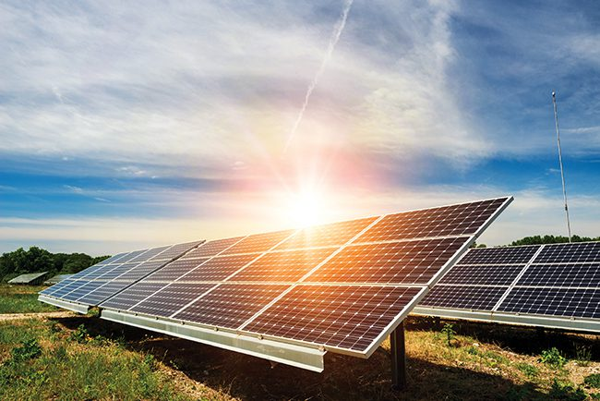
Problem Statement
Brief Overview:
Solar power plants are pivotal in transitioning to clean energy, but maintaining large solar farms is challenging. Equipment failures, particularly inverter breakdowns, can significantly reduce power output and lead to financial losses. Traditional time-based maintenance schedules are often inefficient, resulting in unnecessary maintenance or unexpected failures. This case study explores the implementation of AI-driven predictive maintenance to proactively identify potential issues and optimize maintenance efforts.
Using historical sensor data, weather conditions, and energy output metrics, predictive models can forecast equipment failures before they occur. For example, a solar farm in California reduced inverter failures and downtime by integrating machine learning algorithms, which increased energy production and lowered maintenance costs. This approach highlights how technology can enhance operational efficiency while supporting sustainability in clean energy systems.
Source :
https://www.powermag.com/dialing-in-data-key-to-developing-successful-predictive-maintenance/

Slide 3
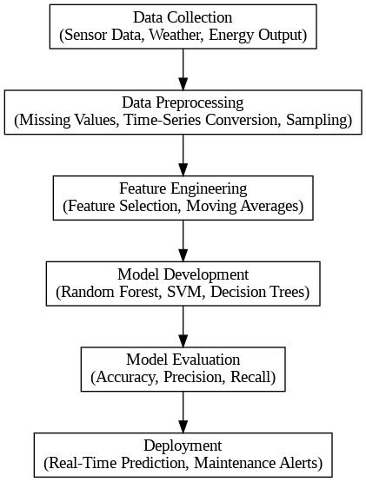
Problem Statement
Key Objectives
Predict Equipment Failures: Use historical sensor data and weather conditions to predict potential failures, focusing on inverters as a critical component.
Increase Energy Output: Minimize downtime and maximize the power generated by the solar panels.
Reduce Maintenance Costs: Transition from reactive to predictive maintenance to optimize resource allocation.
Enhance Sustainability: Reduce waste and the carbon footprint associated with traditional maintenance methods.
Improve Model Accuracy: Develop and refine machine learning models for reliable predictions.
Steps in Model Training
Source :
https://app.diagrams.net/

Slide 4
Dataset Overview
Source: Data sourced from a solar power plant’s energy generation and weather sensor systems.
Size:
Plant_1_Generation_Data (1).csv: 68,778 rows × 7 columns
Plant_1_Weather_Sensor_Data.csv: 3,182 rows × 6 columns
Key Features:
Generation Data:
  DATE_TIME: Timestamp of the data
  DC_POWER: Direct current power from the solar panels
  AC_POWER: Alternating current power from the inverter
  DAILY_YIELD: Daily energy production
  TOTAL_YIELD: Total energy accumulated over time
Weather Data:
AMBIENT_TEMPERATURE: Temperature at the plant site
  MODULE_TEMPERATURE: Temperature of the solar modules
  IRRADIATION: Solar irradiation, indicating sunlight exposure
Use: This data is used to predict potential inverter failures by analyzing power generation, weather conditions, and historical data trends.
Source :
https://www.kaggle.com/datasets/anikannal/solar-power-generation-data

Slide 5
Methodology
Approach
Data Collection: Collected data from the solar plant’s energy generation and weather sensors, including power output, temperature, and irradiation.
Data Preprocessing: Handled missing values, sampled the data, and converted time-series data (e.g., DATE_TIME) into a usable format.
Feature Engineering: Selected relevant features (DC/AC power, temperature) and created derived features like moving averages to improve predictions.
Model Development: Trained a machine learning model on historical data, splitting the data into training and testing sets.
Model Evaluation: Evaluated the model using accuracy, precision, and recall, and fine-tuned to improve performance.
Deployment: Deployed the model for real-time inverter failure prediction to enable proactive maintenance.
Source :
https://www.geeksforgeeks.org/sklearn-classification-metrics/

Slide 6
Algorithm Used:
Random Forest Classifier:
  Reason: Random Forest was chosen for its ability to handle large datasets with high dimensionality. It is robust to overfitting and can handle both numerical and categorical features effectively.
Support Vector Machines (SVM):
  Reason: SVM is effective for high-dimensional spaces and was tested to see how well it classifies failure and non-failure conditions. It’s particularly useful when data is not linearly separable.
Decision Trees:
  Reason: Decision Trees were used as an interpretable model to understand the decision-making process behind the failure prediction.
Source :
Random Forest Algorithm - Towards Data Science

Slide 7
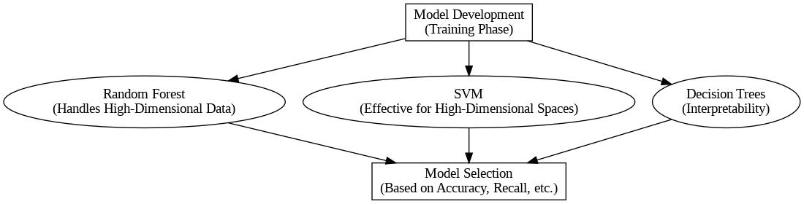
Flow of Model

Slide 8
Conclusion
The predictive maintenance model for solar power systems successfully leverages machine learning techniques to predict inverter failures and enhance system reliability. By analyzing historical data on energy generation and weather conditions, the model can identify patterns that precede failures, enabling proactive maintenance.
The use of algorithms like Random Forest, SVM, and Decision Trees proved effective in handling complex, high-dimensional data and providing actionable insights. With a reduction in unplanned downtime and maintenance costs, this AI-driven approach contributes to improved energy production and operational efficiency.
Overall, predictive maintenance not only optimizes performance but also aligns with sustainability goals, reducing waste and extending the lifespan of critical equipment in solar power plants.

Slide 9

Future Work
Improved Model Accuracy: Enhance prediction accuracy by adding more features (e.g., real-time sensor data, advanced weather forecasts) and exploring deep learning techniques.
Real-Time Monitoring: Implement real-time data feeds to dynamically update the model and provide timely maintenance alerts.
Integration with IoT: Combine with IoT devices for continuous data collection and automated failure detection.
Scalability: Expand the model to include other renewable energy sources and adapt to different geographical regions.
Cost-Benefit Analysis: Conduct a detailed analysis to quantify the savings from predictive maintenance vs. traditional methods.
Source :
https://www.raicoon.com/en/resources/embrace-the-future-of-predictive-maintenance-services-with-optimized-solar-operations

Slide 10
References
Hossain, M. A., Hossain, M. S., Hossain, M. J., & Al-Hammadi, M. (2025). Review of Recent Advances in Predictive Maintenance and Cybersecurity for Solar Panel Systems. Sensors. Retrieved from https://www.mdpi.com/1424-8220/25/1/206
Kumar, A., Singh, B., & Mohan, C. K. (2023). Machine Learning-Based Predictive Maintenance System for Industrial Machines. IEEE Transactions on Industrial Informatics. Retrieved from https://ieeexplore.ieee.org/document/10664535
Zhang, D., Wang, E., & Li, F. (2024). Comparative Analysis of Machine Learning Models for Predictive Maintenance. Electronics. Retrieved from https://www.mdpi.com/2079-9292/13/2/438
Lee, S., Kim, H., & Park, J. (2023). Machine Learning Models for Solar Power Generation Forecasting in Microgrid Applications. Sustainability. Retrieved from https://www.mdpi.com/2071-1050/16/14/6087
Rossi, L., Brunelli, M., & Bianchi, G. (2022). Machine Learning Approach for Predictive Maintenance in Industry 4.0. IEEE Access. Retrieved from https://ieeexplore.ieee.org/document/8449150

Slide 11
Thank You
Notes:
Thank You !!

